Slide 1
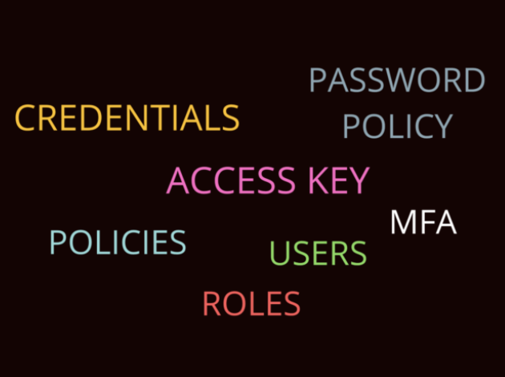
Dynamic Secrets: Unleashing the Thor's Hammer ⚒️ of FOSS Security
- Sakshi Nasha

Slide 2




About me

Slide 3


Let’s connect over LinkedIn :

Slide 4
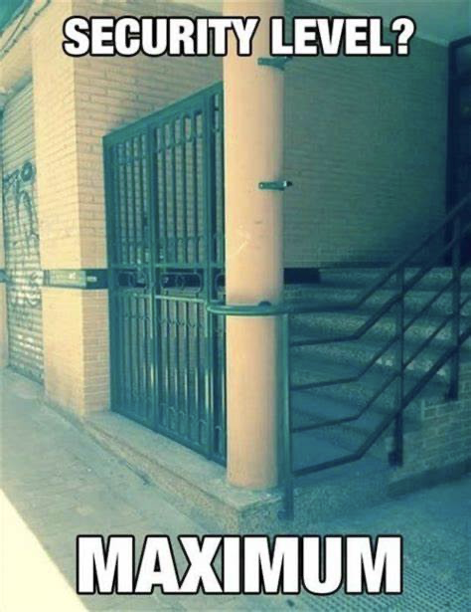
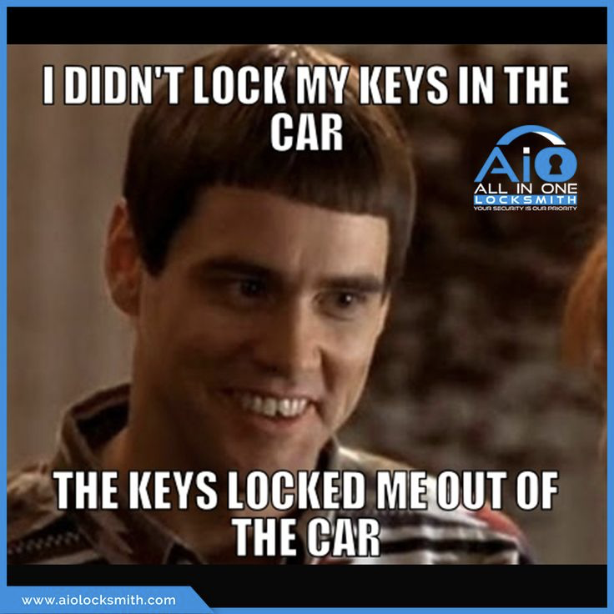
How much security is too much security for you ?

Slide 5
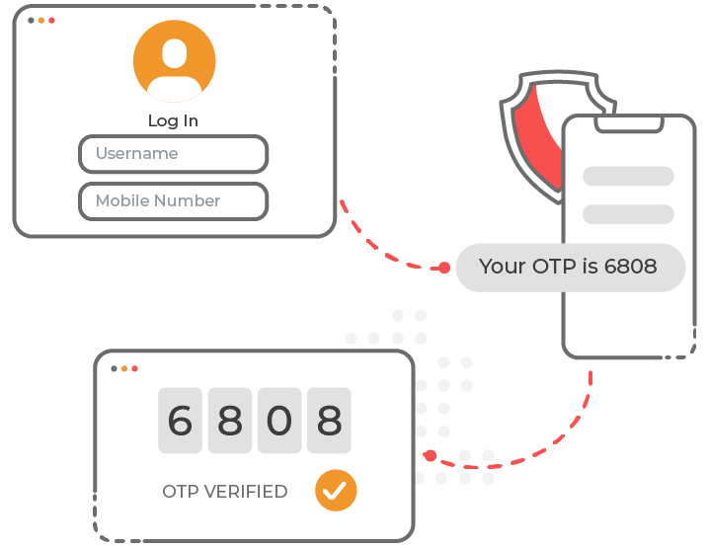
Real Life Example
Login Authentication : Bank Website
AWS account verification 2MFA
Transaction Confirmation : Credit card / Debit card
Email Verification
Microsoft Authenticator – Company Portal

Slide 6
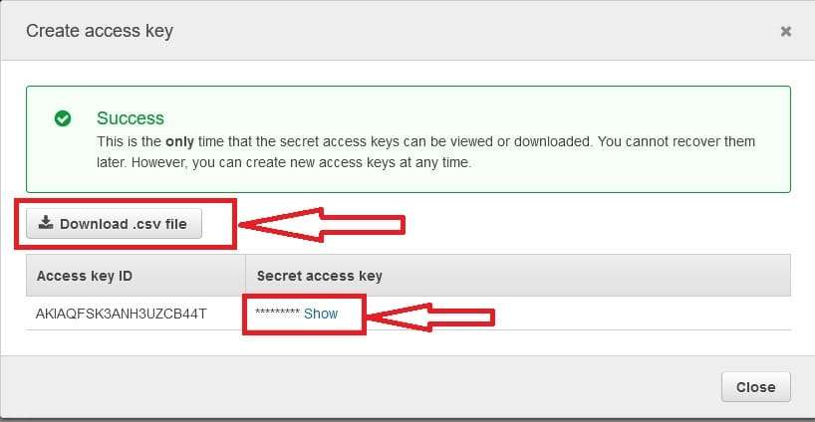
Diagram1: Creating a Credential (Access key and secret) with the AWS S3 bucket (IAM ROLE)

Slide 7
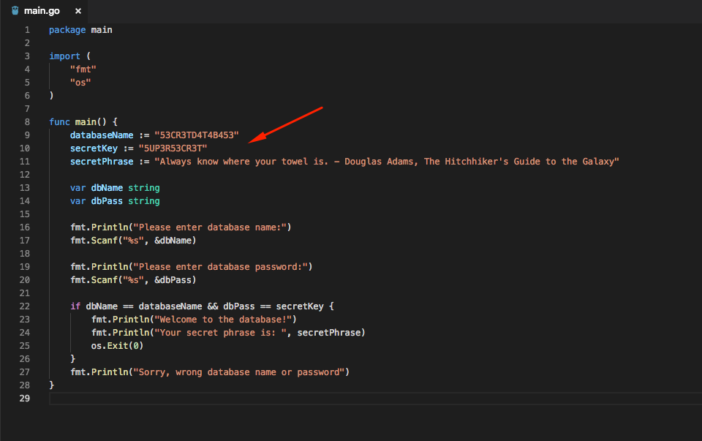
Hardcoding secrets in the code

Slide 8
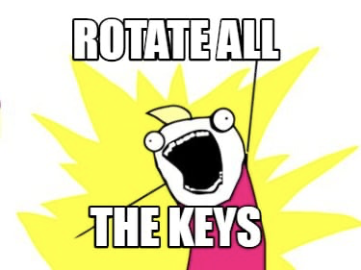

Static Secrets v/s Dynamic Secrets
Static secrets are secrets that are pre-defined and do not change unless explicitly modified by an administrator or authorized user.
Examples: API keys, database passwords, or encryption keys that remain constant over time unless intentionally rotated.
Dynamic secrets are credentials or tokens that are generated programmatically and have a short lifespan. They are typically generated on-demand and automatically revoked after a specified time period or usage.
Examples : Temporary Access, Session Token or Short-lived tokens , Temporary Service Accounts(created from automation scripts or microservices)

Slide 9
Current key Challenges faced with managing and storing secrets
Security Risks: Leakage or unauthorized access to secrets such as passwords, API keys, and tokens can lead to data breaches and compromise sensitive information.
Integration Complexity: Seamlessly integrating secrets management solutions across diverse environments, including on-premises and multi-cloud setups, can be complex and challenging.
Balancing Security and Flexibility: Finding a balance between robust security measures and maintaining operational flexibility to support agile development and deployment practices.
Cost Management: High costs associated with proprietary secrets management solutions (licensing fees, operational expenses)
Manual Processes: Tedious manual processes for key rotation, encryption, and distribution of secrets.
Compliance and Governance: Ensuring compliance with industry regulations and internal governance policies while managing secrets securely.
Scalability: Scaling secrets management solutions to accommodate growing volumes of credentials and applications in dynamic cloud-native environments

Slide 10


TODAY, we will generate a short-lived token for our own application

Slide 11
Agenda of Workshop
Introduction
Installation
Basic CRUD Operations
Using AWS secret Engine
Generating Dynamic Secrets : harnessing the POWER of FOSS tool
Operations by Using AWS Dynamic Secrets
Lease : renewal, revocation and inspection
AddingTTL (Expiry)
Disabling AWS Secret Engine
Auto Rotation Policy
Extension to Databases
Other FOSS tools to manage secrets
Summary

Slide 12
Prerequisites
AWS Bucket
AWS IAM USER and AWS IAM Policy
What is HashiCorp Vault
Client Server Architecture
What is Secret Engine

Slide 13
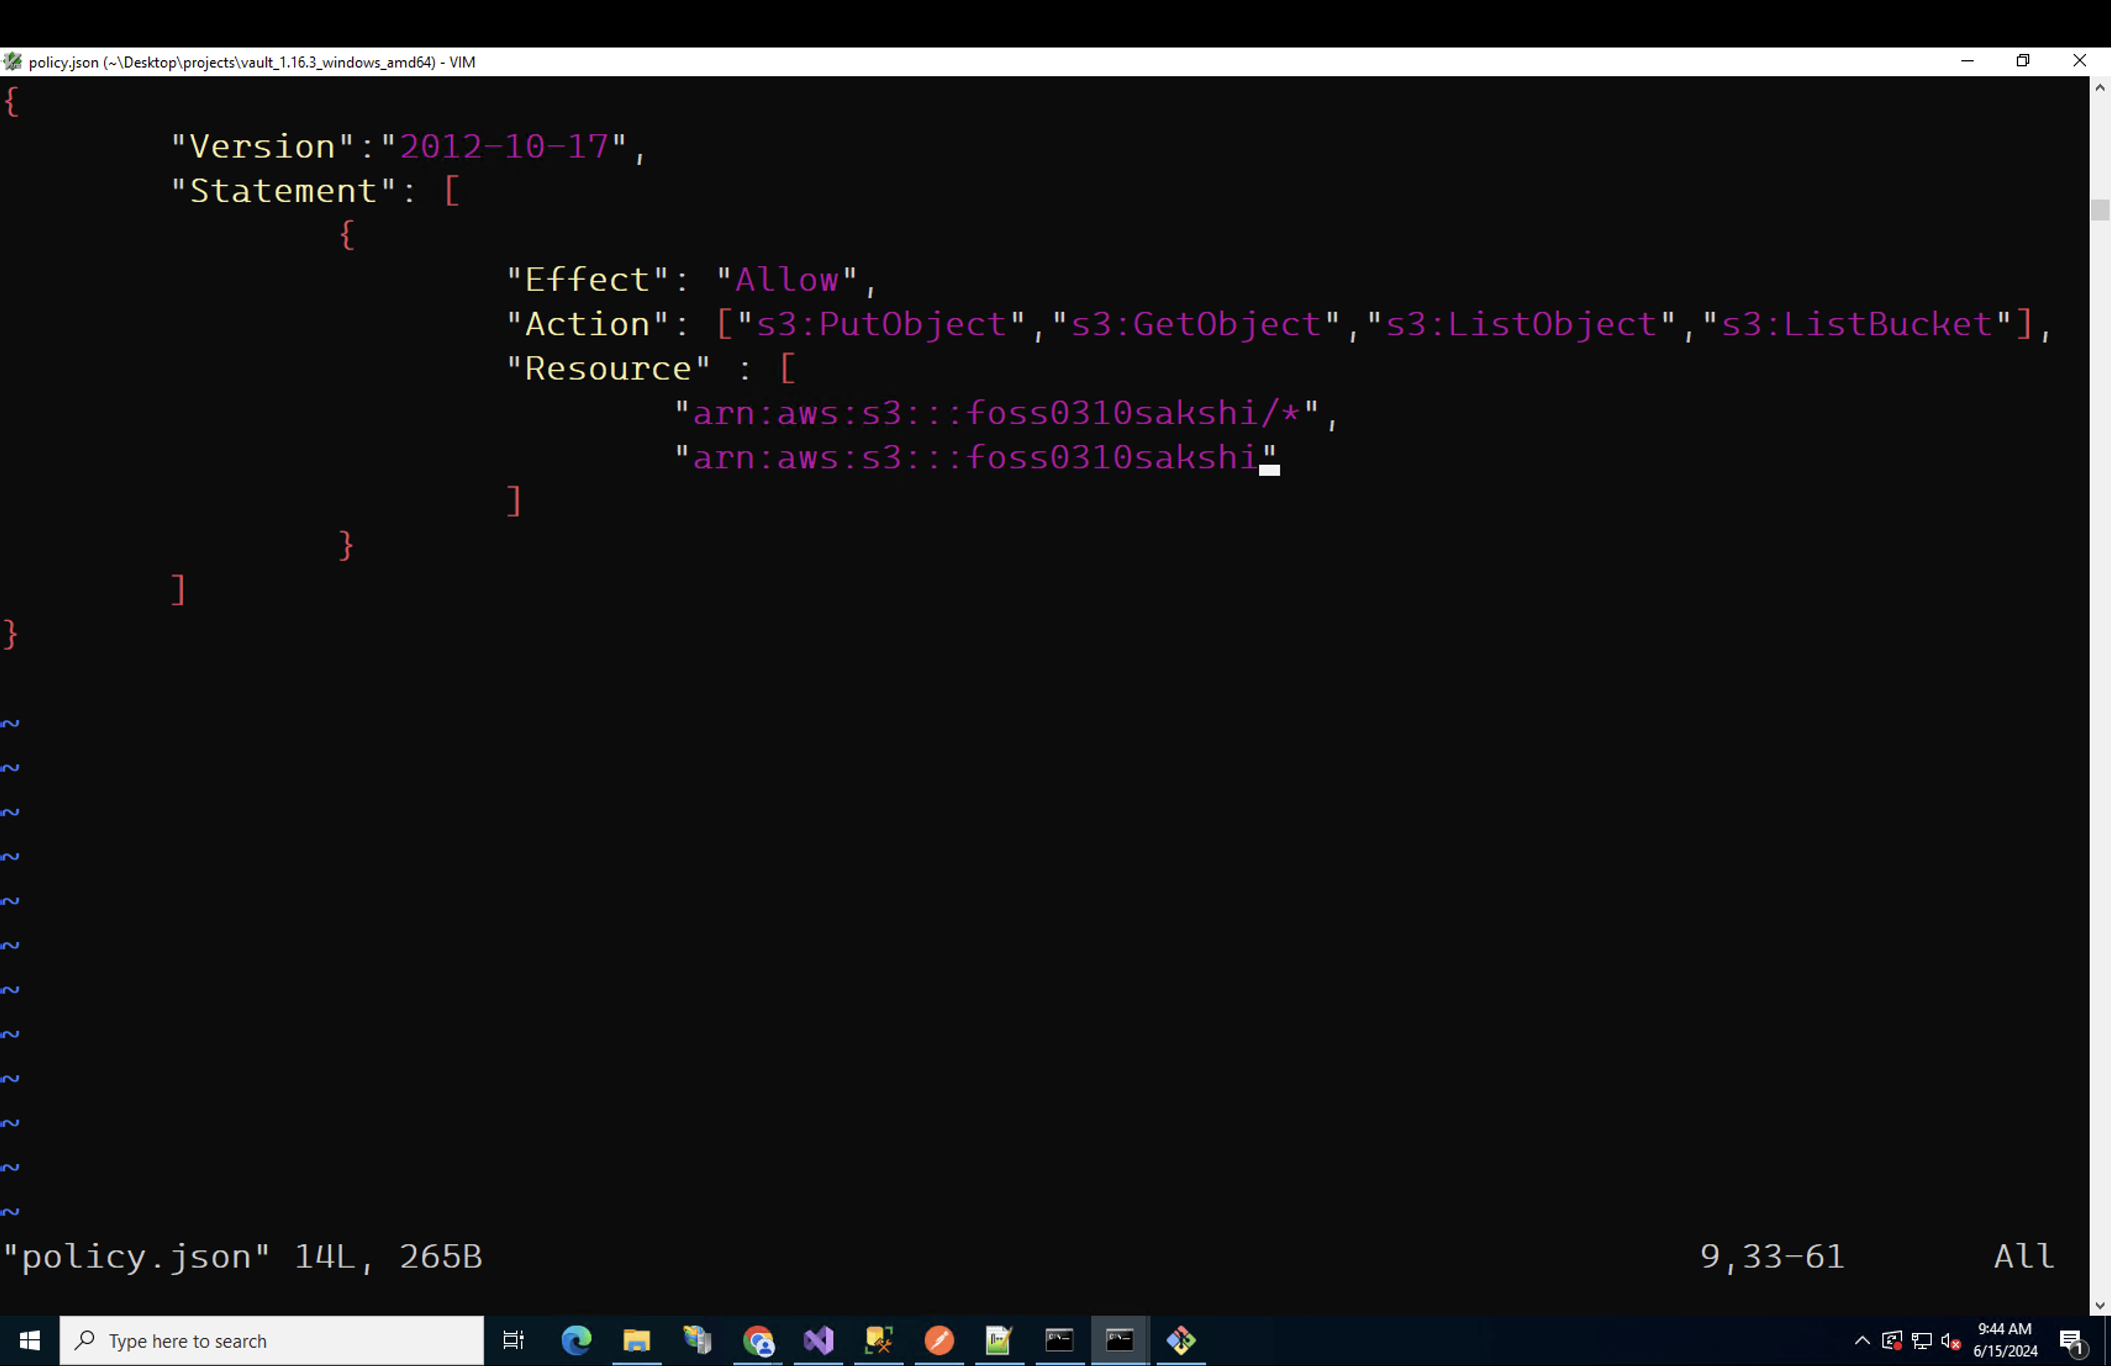
Prerequistics
Amazon Simple Storage Service (Amazon S3) is an object storage service. To know more
AWS IAM (securely control access to AWS resources)
IAM USER : entity that you create in AWS (human user or workload)
IAM Policy : You manage access/permissions in AWS by creating policies and attaching them to IAM identities (users, groups of users, or roles) or AWS resources. AWS evaluates these policies when an IAM principal (user or role) makes a request.
IAM Credentials : keys used to access the AWS resources

Slide 14
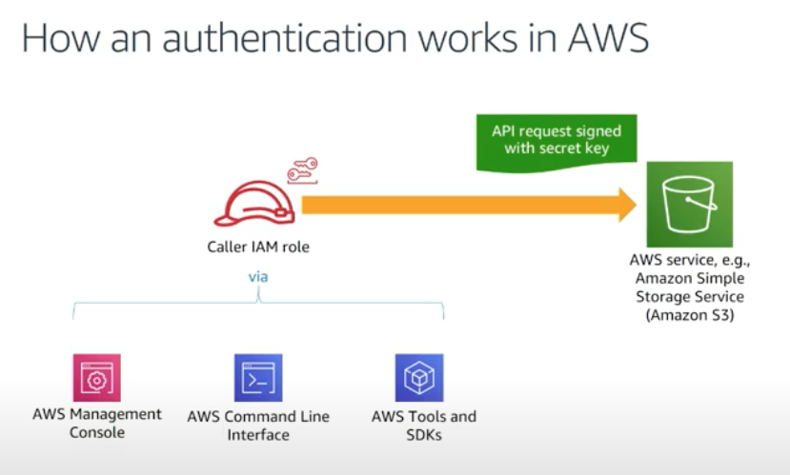

Slide 15

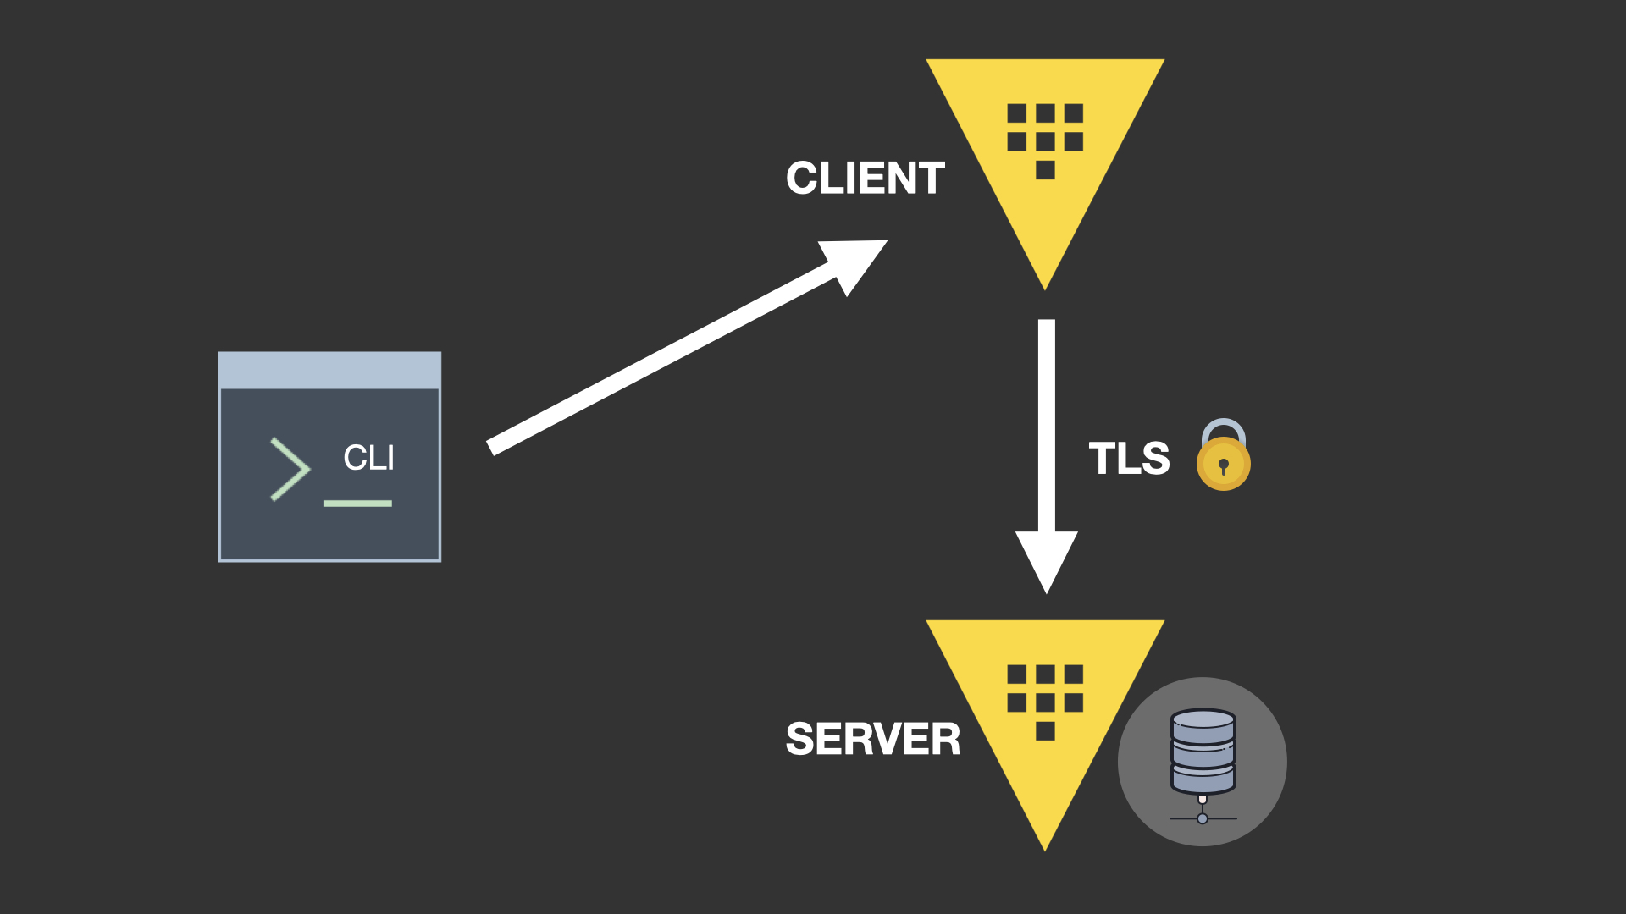
Prerequisites
HashiCorp Vault is a tool for managing secrets and protecting sensitive data.
The client-server model involves a server that provides resources or services and a client that requests and uses those services. The server listens for and responds to client requests, while clients initiate requests and receive responses.
Server: The Vault server is the central component that stores and manages secrets. It handles requests from clients, performs authentication, and provides secret data based on policies.
Client: Clients interact with the Vault server to request secrets, perform authentication, or store new secrets. This can include applications, infrastructure services, or even human users.

Slide 16
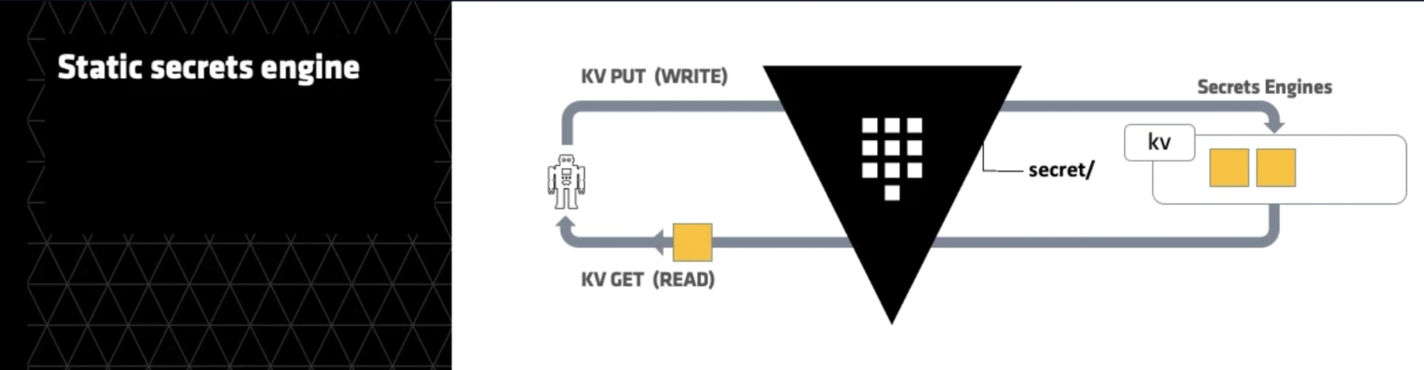
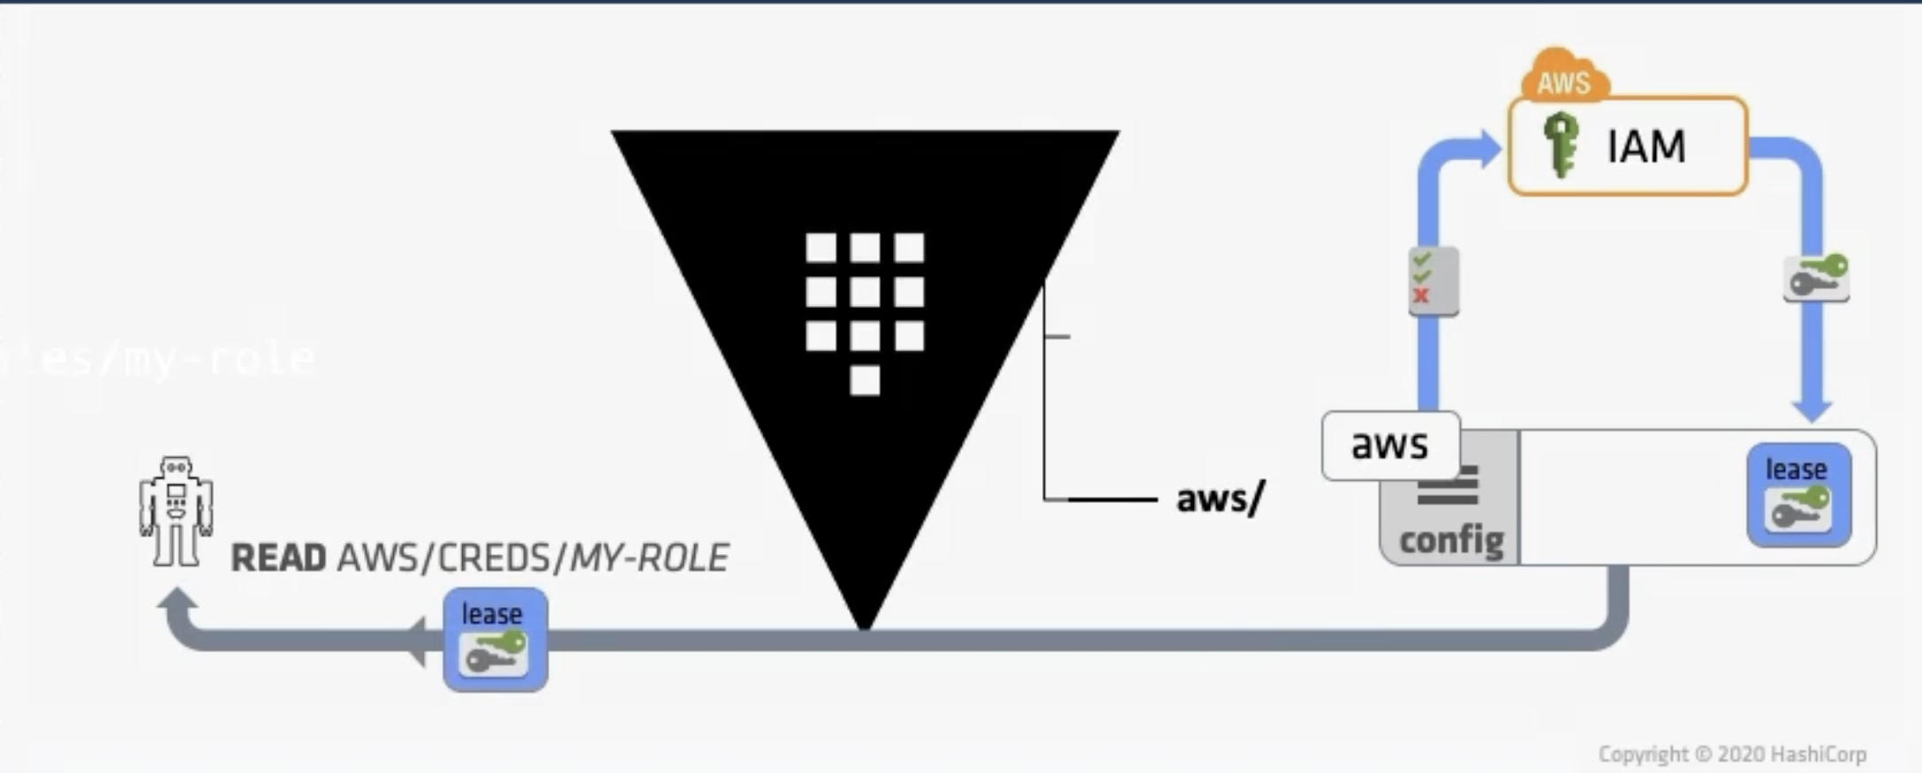
Prerequisites
Secret Engine : is a component that enables the storage, management, and retrieval of specific types of secrets. Each secret engine provides different functionalities, such as generating dynamic credentials, encrypting data, or managing sensitive information, tailored to various use cases like databases, APIs, or key management.
AWS secrets engine : The AWS secrets engine generates AWS access credentials dynamically based on IAM policies.
The AWS secrets engine supports the concept of static credentials as well as dynamic secrets.

Slide 17


Slide 18
Demo
Link :

Slide 19



Perks of using Short lived Tokens
1
2
3
Enhancing Security
Mitigating Token Abuse
Least Privilege Principle
Short-lived tokens have a limited lifespan, reducing the exposure window for potential attacks.
If a token is compromised, its validity period is short, minimizing the risk of unauthorized access.
Regular token expiration forces users to re-authenticate, ensuring better security.
Tokens are often used to authorize access to resources.
By making tokens short lived, we limit the time an attacker can use to abuse a stolen token.
Thus, minimizing the risk window significantly
A user should only have access to what they absolutely need and not what they want.
When permissions change (e.g., user roles or access levels), short-lived tokens automatically reflect the updates upon renewal.
Long-lived tokens may retain outdated permissions, leading to security risks.

Slide 20
Auto Rotation Policy
Auto rotation Policy

Slide 21
Extension to Databases
Dynamic secrets: database secrets engine | Vault | HashiCorp Developer

Slide 22
FOSS Tool
HashiCorp Vault
Keycloak
Seaked Secrets
Free and Open Source Software (FOSS) tools provide robust solutions for securely managing and storing credentials in applications.

Slide 23

“You got the incredible power of FOSS through the Thor's Hammer to protect your the Asgard (Applications) from potential threats ”

Slide 24


USE WISELY

Slide 25
Introducing short lived token-based authentication.
Short lived tokens are JWT (JSON Web Token) with session time
Short-term credentials consist of three parts: Access key ID, secret access key, and a security token.
The users once register their credentials, receive a unique encrypted token that is valid for a specified session time. During this session, users can directly access the website or application without login requirements.
You can create these tokens using AWS Security Token Service (STS) , Google Short lived creds for service account (GCP) , Azure Storage resources using shared access signatures (SAS)
While creating the tokens, you can specify the duration : How long the STS/SAS is valid.
Examples : Financial applications ( ICICI Bank, HDFC Bank ), Sensitive Multi Cloud applications

Slide 26
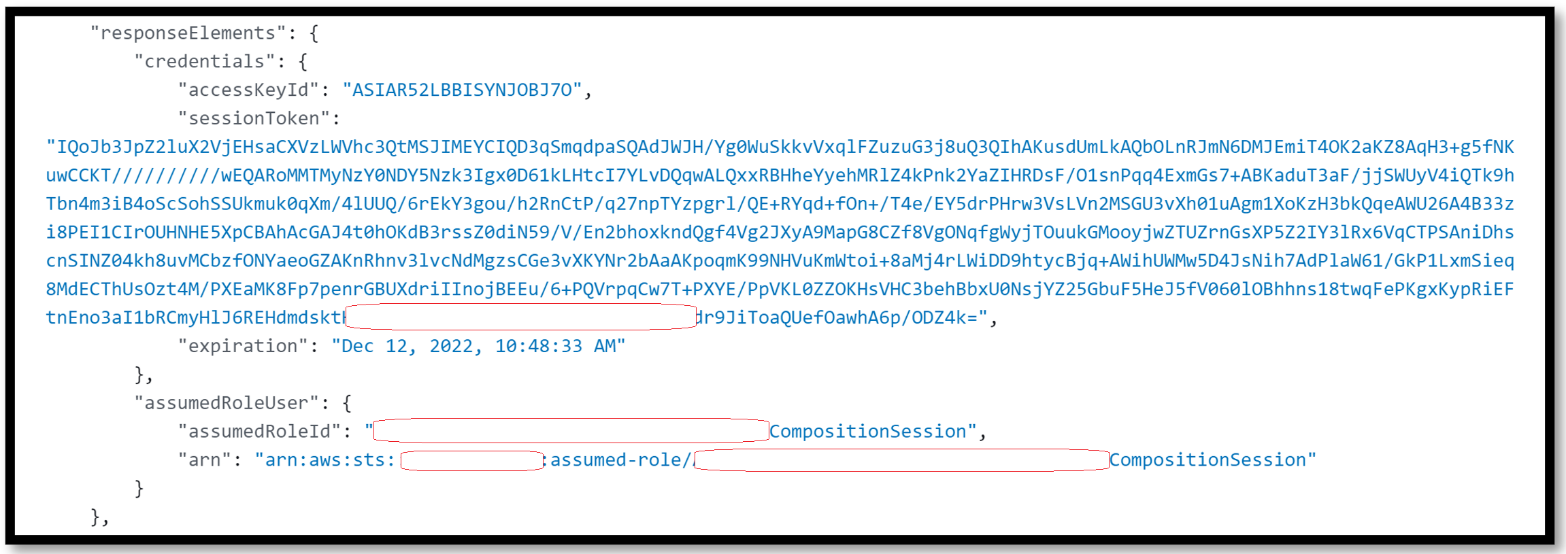

Slide 27
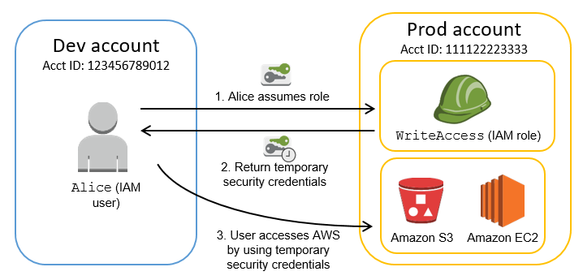

Slide 28





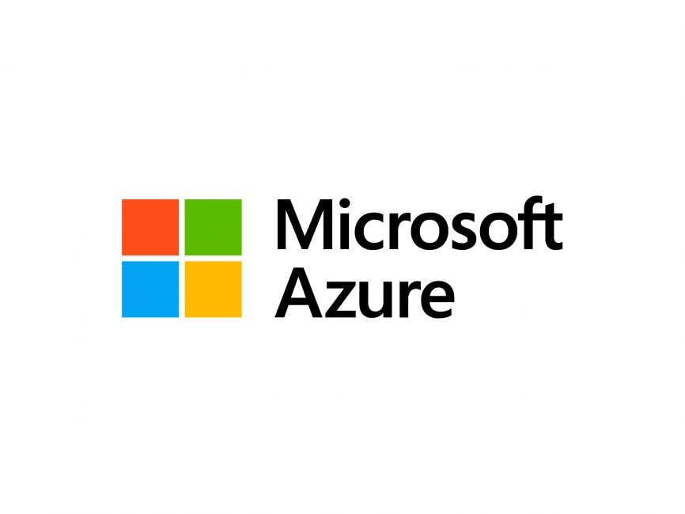
Future References :

Slide 29



Future References :
My VOX

Slide 30



